Slide 1
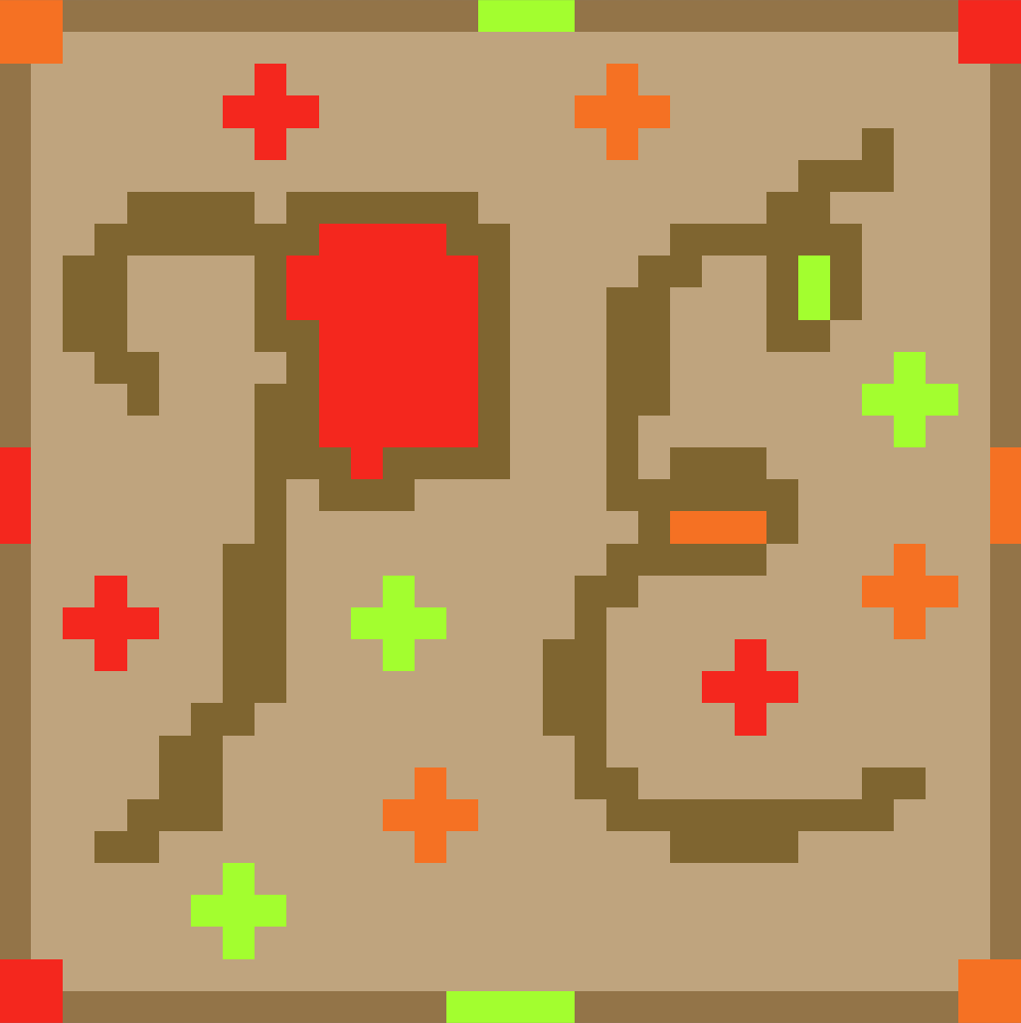
Project: Egress
Prototype logo below made with Piskel:

Slide 2
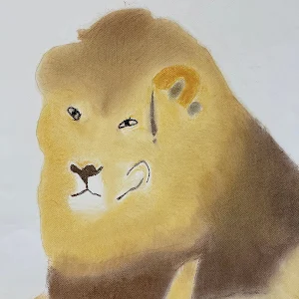


The Developers:
Liam Bragg
Role: Lead Developer & Programmer
Ethan Todd
Role: Lead Artist & Programmer
Madeline Rosshirt
Role: Programmer & Artist

Slide 3


Background & Overview:
“Project: Egress” will be a 2D puzzle platformer and shooter game
The player will go through rooms with a variety of puzzles and traps
The player must use their paint and tools to solve these puzzles
The paint you use will have different effects
Their will be a variety of methods to spread said paint
Ideally, there will be a sandbox mode too

Slide 4


What do we Need and Why?:
Piskel
Most of the sprites and animations will be made using the website
Ex. The “Project: Egress” logo
Visual Studio Code
IDE to write scripts
We have plenty of experience with this
Unity
Game engine the game will run on
There is a decent amount to learn about

Slide 5

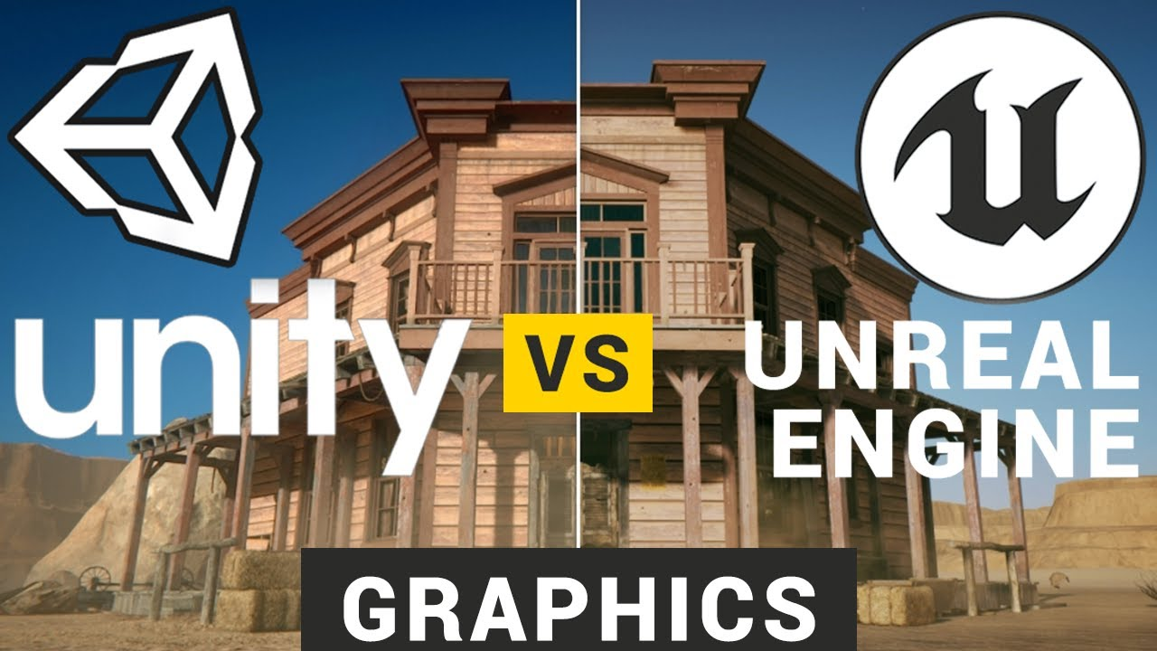
What is Unity? - Unity Overview:
Unity is a game engine that supports both 3D and 2D games
Developers use a workspace with an editor that supports C# to create games
There are many famous games built with Unity:
Hollow Knight Series
Among Us
Cuphead
Genshin Impact

Slide 6

Possible Problems:
We all have little to no experience with making actual games
Production will be slow
Game mechanics will need to be polished a lot
There will be numerous bugs (but if they are fun then we might leave them in)
No live-collaboration in Unity
Might not be a problem, but it will slightly complicate the process of combining work

Slide 7

Why this Project?:
Game development is interesting, but also complex
Scope management, game balancing, and being unique
Creativity
Unique mechanics, art style/theme, and easter eggs or secrets
It’s challenging
Constraints: People and Time
We are not currently very adept at game development
In the end, it’s about learning new skills and adapting!

Slide 8

Project Timeline
Weeks 1-4
(Short) Learning C#
Design: movement, shooting 1 color
Weeks 5-9
Finish other colors
Design: levels, game asset art, sandbox area
Week 10
Polish for midterm
Midterm Presentation
Weeks 11-20
Design: more levels, color tools, player HUD
Polish implemented features
Game storyline (if time permits)
Final Presentation

Slide 9
Thank You!
Feedback?

